Slide 1


DAB401
FINANCIAL ANALYTICS
St. Clair College
Walmart Stock Analysis
Group Members
Apurv Sathwara
Bhakti Bhatt
Dhrumi Patel
Smit Arora
Vismay Lad

Slide 2
Agenda
Introduction
Company Valuation
Business Model
Competitors
Market Share
Balance Sheet
Ratio Analysis
Recommendation

Slide 3

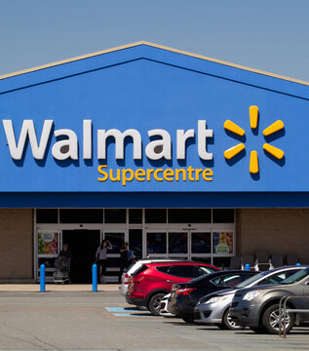
About Company
Walmart is an American multinational retail corporation that operates a chain of discount department stores, grocery stores, and hypermarkets.
Founded in 1962 by Sam Walton in Bentonville, Arkansas, Walmart has become one of the largest retailers in the world with over 11,000 stores in 27 countries.
The company is known for its low prices and wide range of products, including clothing, electronics, groceries, and household items.
Walmart has also been a pioneer in the use of technology, implementing advanced inventory management systems, automated warehouses, and digital innovations to enhance the customer experience. With a focus on innovation, sustainability, and community engagement, Walmart has become an iconic brand that has changed the face of retailing around the world.

Slide 4
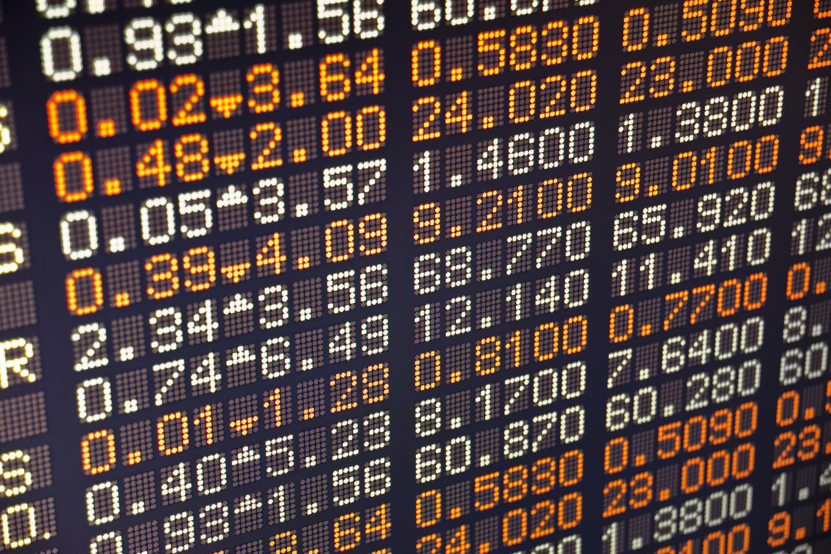
HQ -Bentonville,Arkansas,US
Public entity
Number of employees- 2.3 M
Revenue - $ 611.3 billion
Market Capital- $ 403.05 billion
Net income -$ 11.29 billion
Share Price - $ 149.52
Market Share in Canada- 8%

Slide 5
Mergers and Acquisitions
Number | Year | Company | Country | Price
1 | 1994 | Woolco | US | $ 300M
2 | 1999 | ASDA | UK | $ 10B
3 | 2016 | Jet.com | US | $ 3.3B
4 | 2017 | Bonobos | US | $ 310M
5 | 2018 | Flipkart | India | $ 16B
Walmart has made 27 acquisitions and 17 investments.
The company has spent over $ 21.94B for the acquisitions.
Walmart has invested in multiple sectors such as Fashion Tech, E-Commerce Enablers, Logistics Tech and more.

Slide 6
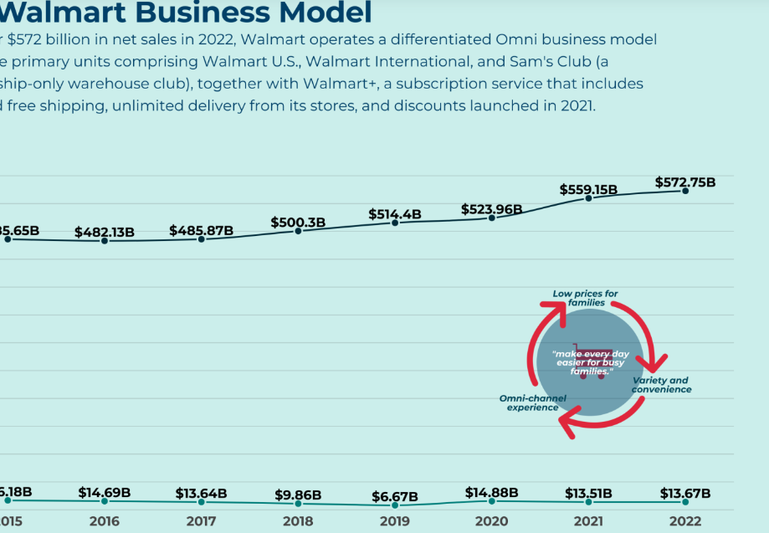
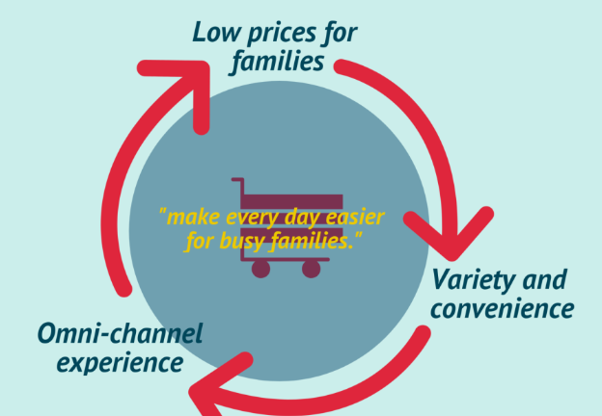
Business Model
With over $555 billion in net sales in 2021, the company operates a differentiated Omni business model with three primary units comprising Walmart U.S, Walmart International, and Sam’s Club (approximately 12% of its net sales) a membership-only warehouse club.
Together with Walmart+, a subscription service including unlimited free shipping, unlimited delivery from its stores, and discounts launched in 2021.

Slide 7

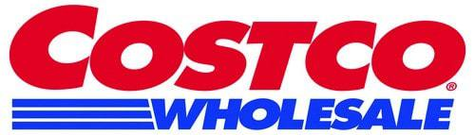







Competitors

Slide 8
Competitor’s Market Share & Share Price
Company’s Name | Market Share in Canada | Share Price (USD $)
Costco | 9% | $ 493.94
Loblaws | 28% | $ 92.68
Sobeys | 20% | $ 27.12
Metro | 11% | $ 56.11

Slide 10
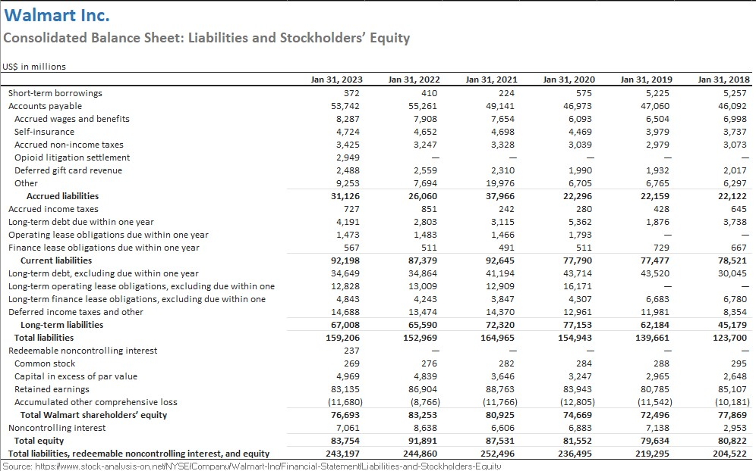
Balance Sheet

Slide 11
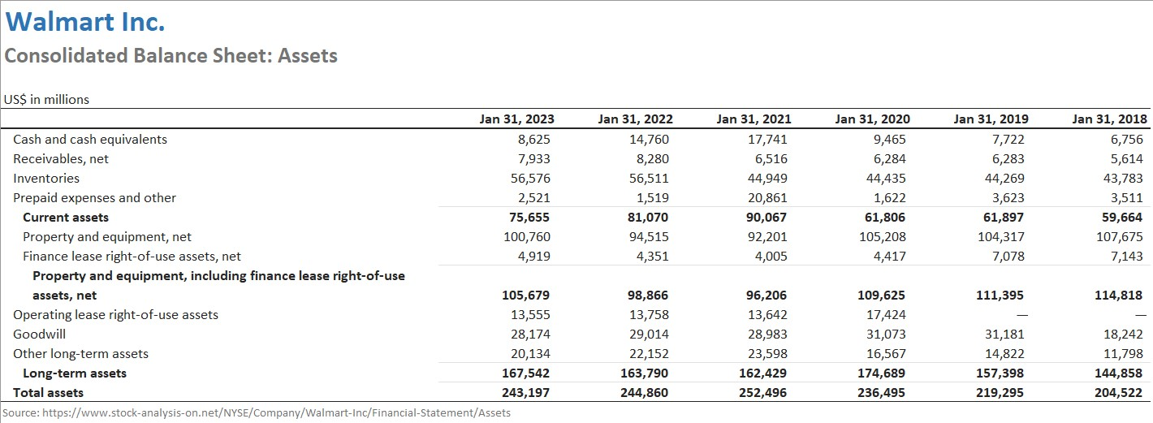
Ratio and valuation Analysis

Slide 12

Ratio Analysis
Used to evaluate a company's financial health and performance across different areas.
Liquidity Ratio
Profitability Ratio
Other Ratio

Slide 13
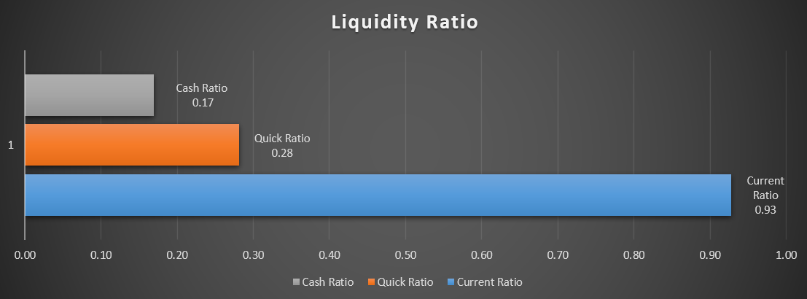
1.Liquidity Ratio

Slide 14
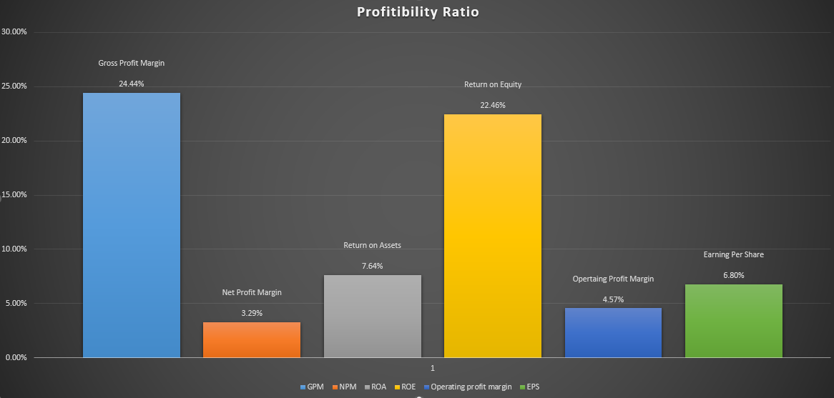
2.Profitability Ratio

Slide 15
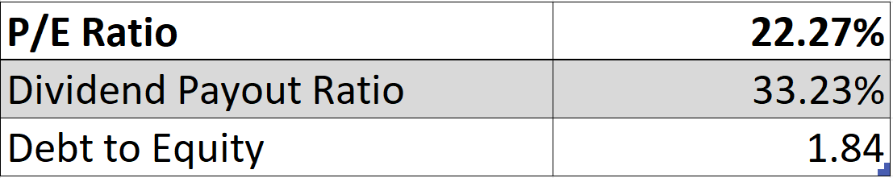
3.Other Ratio

Slide 16
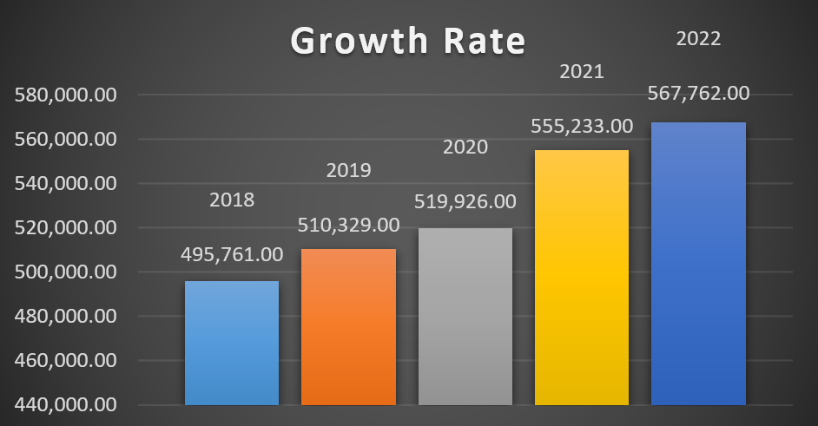
Growth Rate

Slide 17
Capital Asset Pricing Model
Financial model used to calculate the expected return and risk of an investment by considering the risk-free rate of return, the expected market return, and the asset's beta.

Slide 18
Beta (β) - Volatility in relation to the overall market.
Beta (Yahoo Finance)
β = 0.49
5y Monthly
Beta of 0.49 indicates stock is 51% less volatile than market.
Beta (Calculated)
β = 0.50
5y Monthly
Beta of 0.50 indicates stock is 50% less volatile than market.
Beta is an estimation of volatility, and there is always some error associated with any estimation method

Slide 19
CAPM Model
​Ra​=Rf​+βi (Rm​−Rf​)
where:
Ra​=expected return of investment
Rm = S&P500 Return
Rf​=risk-free rate (Treasury Yield 5 Years)
βi​ = beta of the investment
-> 3.53%+0.50*(8.90%-3.53%) = 6.20%
*It means that the expected return of the investment, on the WALMART stocks, is 6.20% per year

Slide 20
Monte Carlo Simulation
Monte carlo simulation is at it core, a simple technique that uses random sampling to simulated real-world phenomena.
Monte carlo methods are used when we are interested in a problem that could be deterministic in principle but for which it could be hard to know the exact answer.
Therefore, we leverage randomness to estimate our answer.
The technique is used for forecasting.
The algorithm relies on repeated random sampling in an attempt to determine the probability.

Slide 21
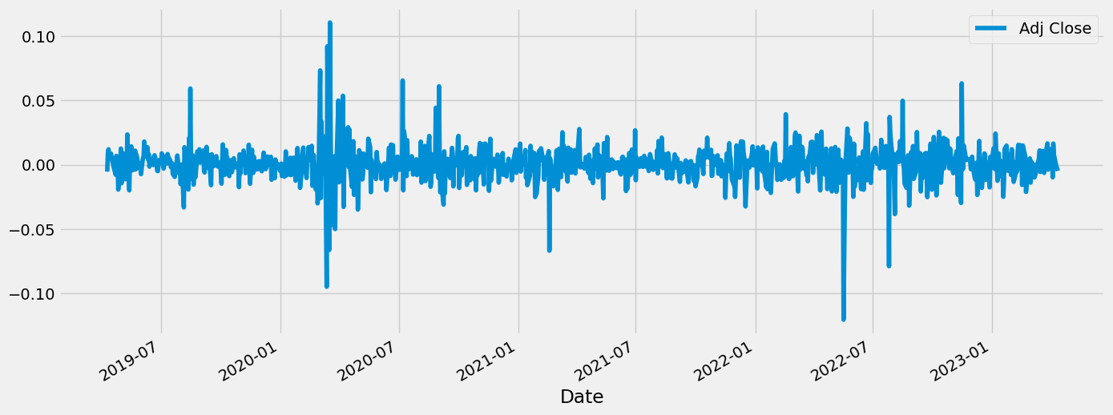
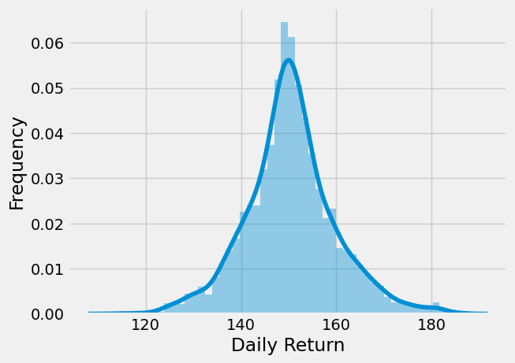
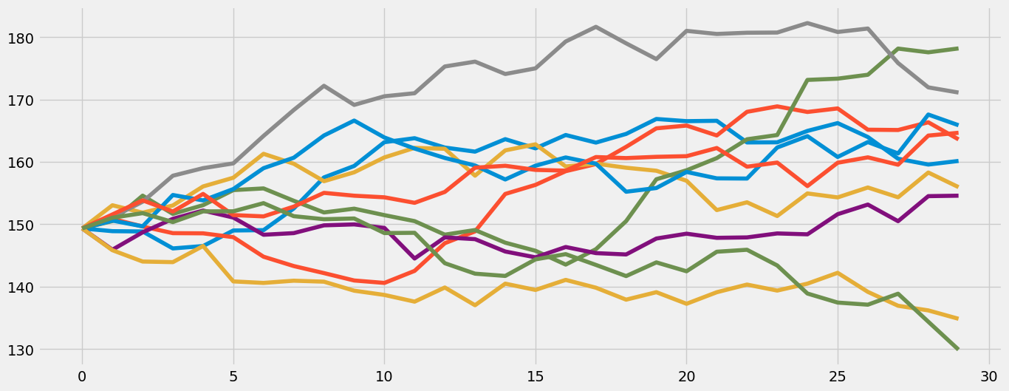
Monte Carlo Simulation

Slide 22
Here, the monte carlo simulation represents the normal distribution (a bell shape) in which almost all the data points fit perfectly.
You can see that the majority of scenarios are gathered around the middle points. This is where the most likely results lie.
The result is 30th simulation stock at the end of 30th days. None has happened to fell below 130 and one is above 180 adj. closed values.

Slide 23
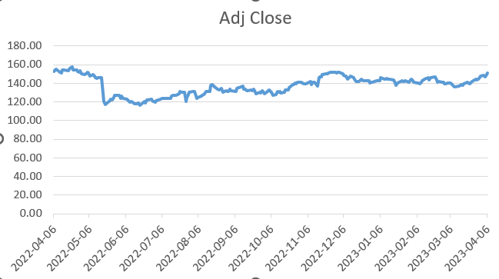
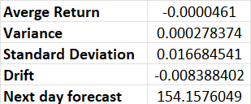
Monte Carlo Simulation
After running a Monte Carlo simulation of Walmart's adjusted closing price for the past two years, it was found that the expected average stock price for the next 30 days is higher than the current market price.
This implies that there is a possibility of a rise in the stock price in the short term.
Nevertheless, investors must note that this simulation does not ensure future stock price movements and further research and analysis should be conducted before making any investment decisions.
Furthermore, stock investment involves risks, and past performance may not predict future results.

Slide 24
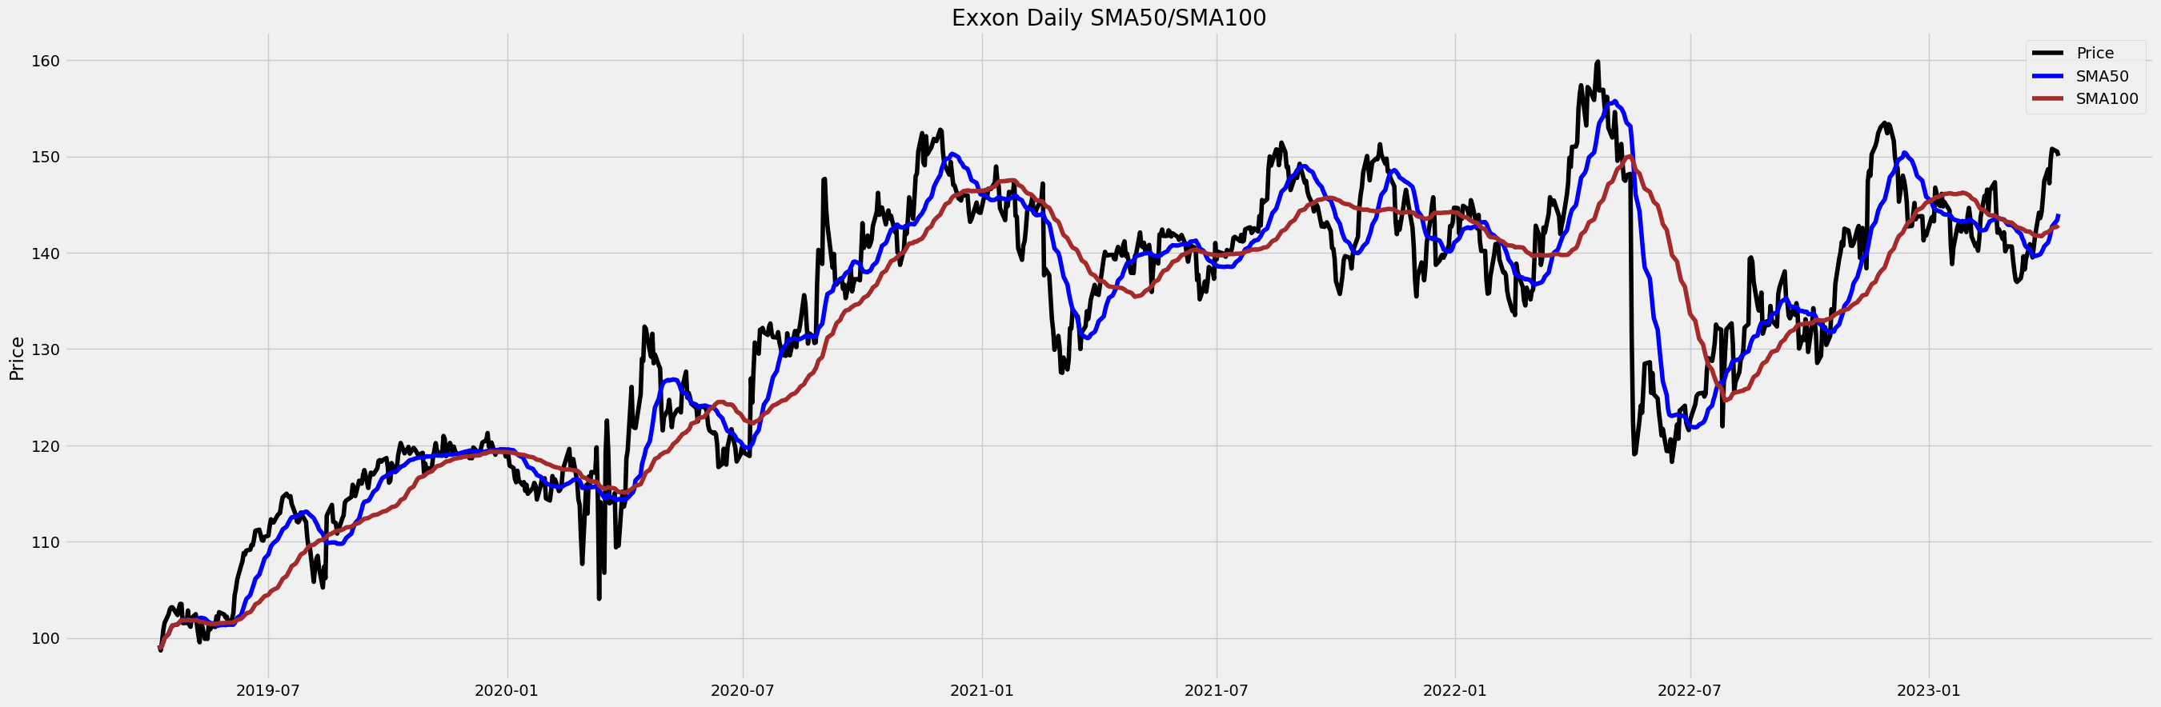
Simple Moving Average
As you can see in the plot, we have our stock's closing price as a 50-day and 100-day simple moving average.

Slide 25
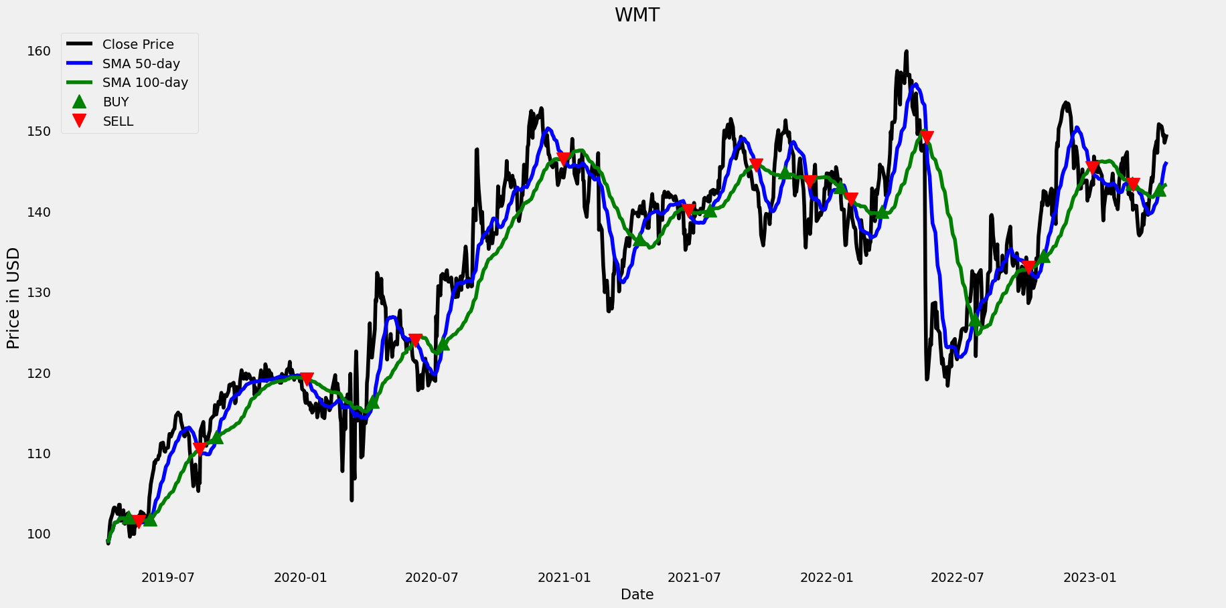
Golden Point, Buy Sell Predictions This Chart shows the short- and long-term stock predictions and it always increased after reaching the Golden Point, So we can be able to understand where to Buy and Sell the Stock.

Slide 26
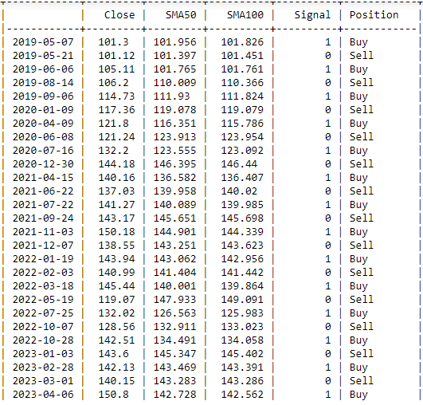

Slide 27
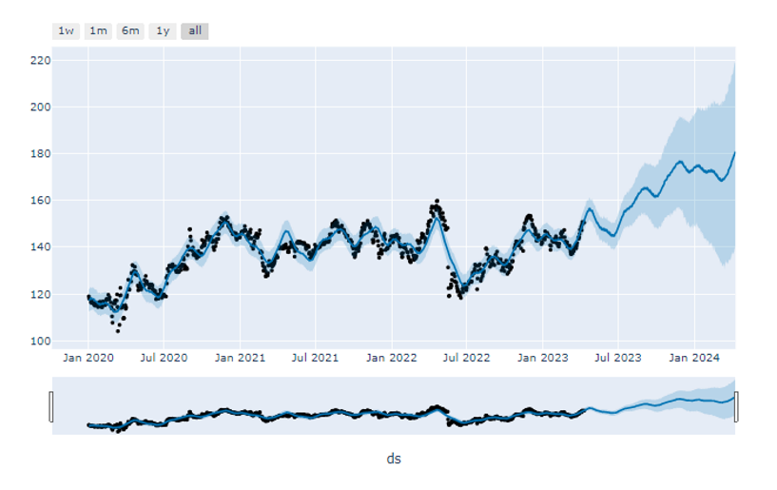
Facebook Prophet
The output of the above model is a predicted time series of future stock prices for Walmart (ticker: WMT).
The model uses the historical data of WMT stock prices from January 2020.
To make predictions for the next 365 days using the Prophet library.
The predicted stock prices gradually increase over time with occasional dips, and the uncertainty of the predicted stock prices increases over time as well, as indicated by the increasing width between 'yhat_lower' and 'yhat_upper’.

Slide 28
Recommendation
Walmart is a major global retailer whose stock is regarded as a blue chip.
Walmart's fundamentals may be shifting from what was formerly thought of as a value investment.
Costco and Loblaws cannot match the company's impressive financial performance.
Walmart outperforms its two main competitors in terms of price-to-earnings and price-to-book ratios, but falls short in terms of return on equity, debt-to-equity ratio, and current ratio.

Slide 29

References
https://pestleanalysis.com/walmart-pestle-analysis/
https://fourweekmba.com/walmart-business-model/
https://businesschronicler.com/competitors/walmart-competitors-analysis/
https://csimarket.com/stocks/competitionSEG2.php?code=COST
https://csimarket.com/stocks/competitionSEG2.php?code=TGT
https://csimarket.com/stocks/competitionSEG2.php?code=HD
https://csimarket.com/stocks/competitionSEG2.php?code=BBY
https://www.feedough.com/the-history-of-walmart/

Slide 30

Thank you

